Slide 1

Facial Emotion Recognition
J022 rishi gandhi

Slide 2
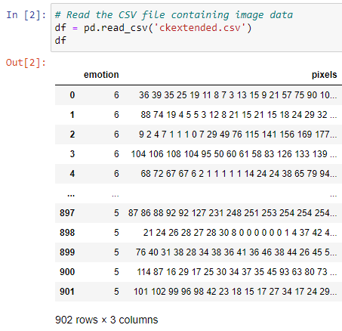
Data Preprocessing
902 Picture images decoded in pixels in 48*48 format.
Also, the images are labeled as:
0 : Anger (45 samples)
1 : Disgust (59 samples)
2 : Fear (25 samples)
3 : Happiness (69 samples)
4 : Sadness (28 samples)
5 : Surprise (83 samples)
6 : Neutral (593 samples)

Slide 3
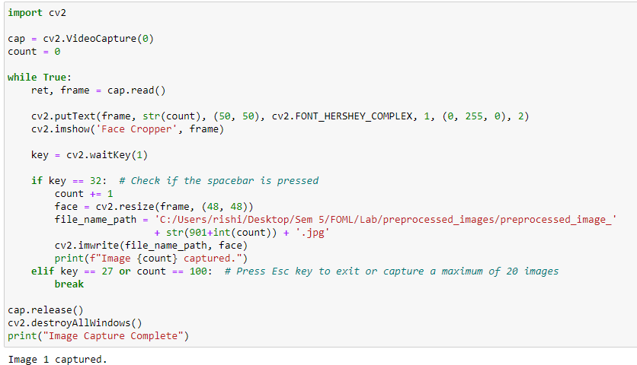
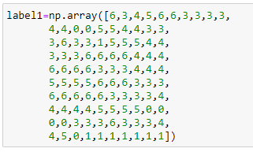
Captured 100 more Facial pictures

Slide 4
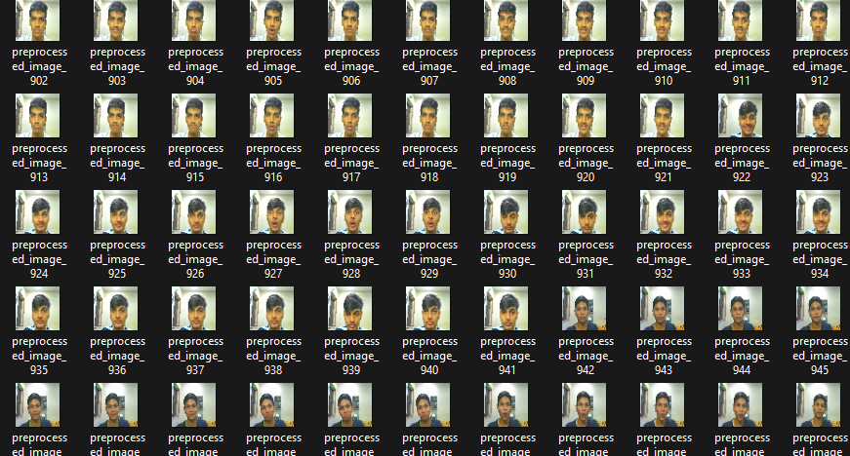
Captured 100 more Facial pictures

Slide 5
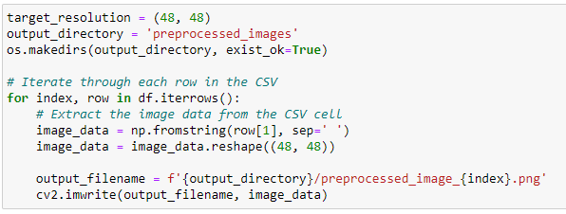
Converting & Storing the Images

Slide 6
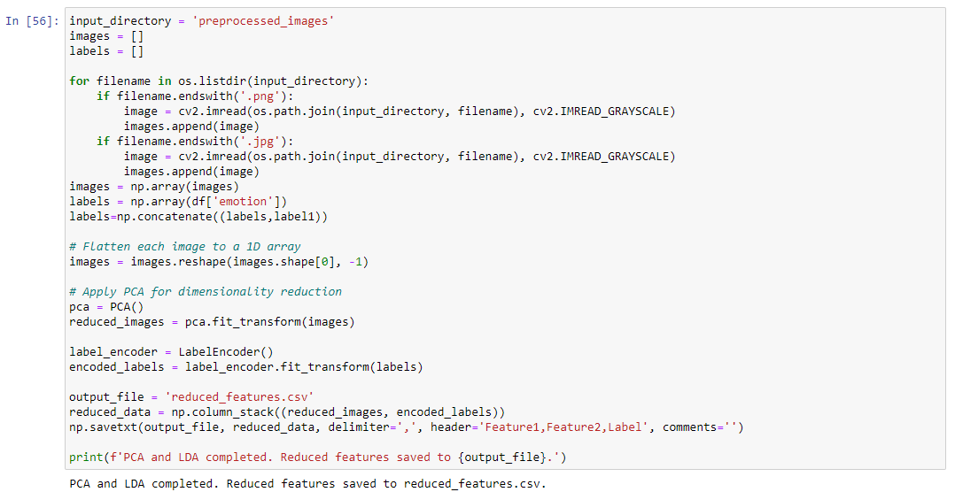

Slide 7
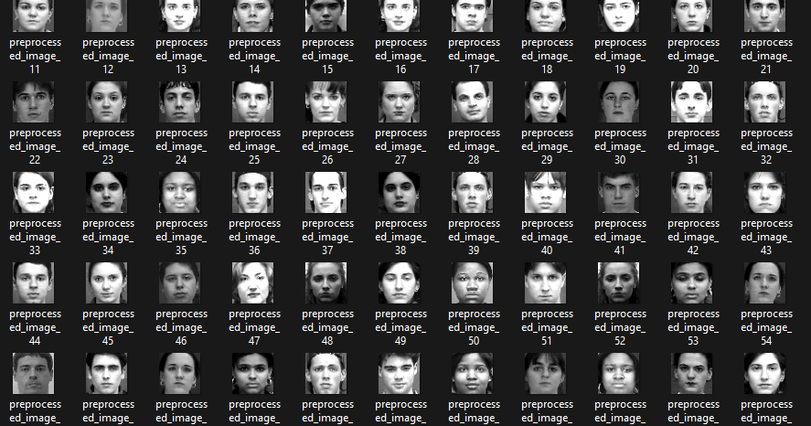

Slide 8
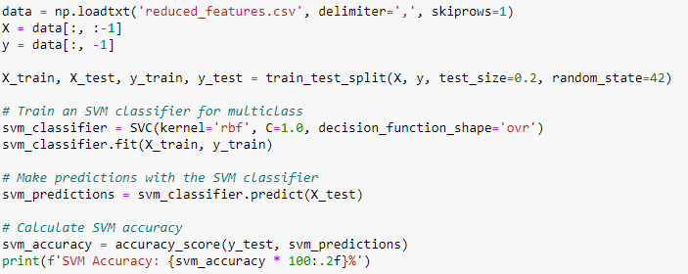

SVM Predictions & Accuracy

Slide 9
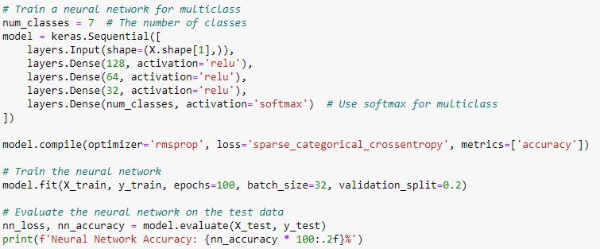
NN Predictions & Accuracy

Slide 10
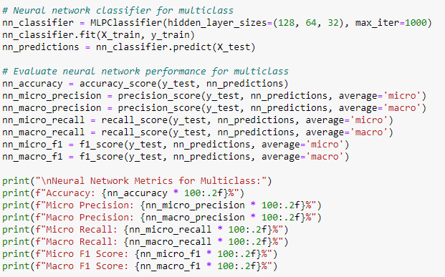
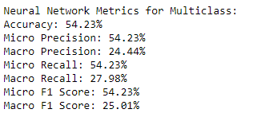
Performance Of NN

Slide 11
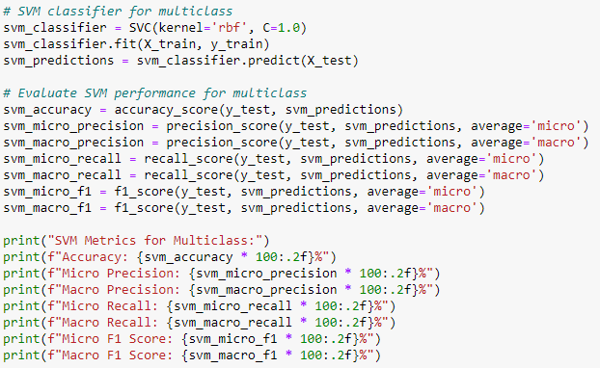
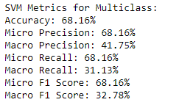
Performance Of SVM

Slide 12
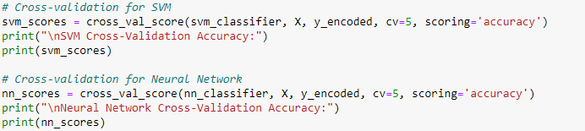

Cross-Validation Scores

Slide 13
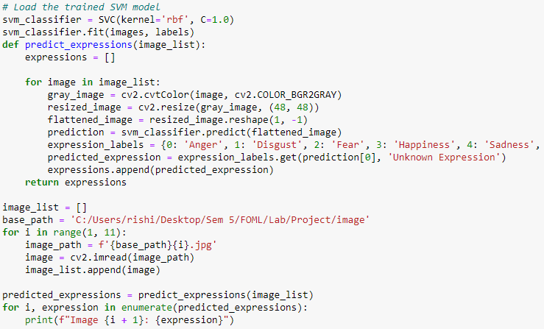
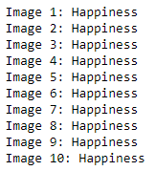
Predicting the Facial emotion

Slide 14
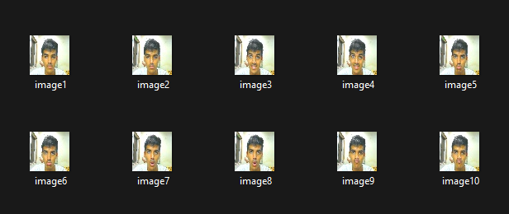
Prediction Images

Slide 15
Thank You
- Rishi Gandhi

